Slide 1


Nutan College of Engineering and Research
FACE DETECTION AND RECOGNITION
Presented by
Guided by
Kishor Rajendra Gaikwad
2064191242110
Under The Guidance
of
Prof. D. V. Dhawase
Submitted for the partial fulfillment
of
B-Tech
in
Computer science and engineering
Nutan College Of Engineering And Research

Slide 2
Content
Project Domain
Title
Problem Statement
Motivation
Hardware/software specification
Abstract
Block diagram
Literature Survey
Conclusion
Nutan College Of Engineering And Research
Nutan College Of Engineering And Research
2

Slide 3
1. Domain
MACHINE LEARNING
Machine learning is a branch of artificial intelligence (AI) focused on building applications that learn from data and improve their accuracy over time without being programmed to do so.
Nutan College Of Engineering And Research
Nutan College Of Engineering And Research
3

Slide 4
2. Title
FACE DETECTION AND RECOGNITION BASED ATTENDENCE SYSTEM
Nutan College Of Engineering And Research
Nutan College Of Engineering And Research
4

Slide 5
2. Problem Statement
The Problem statement of Face Recognition for Real-Time Applications are given below:
Face shape changes by age and face condition.
Blockages on faces for eg. Eye Goggles, Scarf etc.
Similar faces eg. twins may have similar faces
The image quality.
Nutan College Of Engineering And Research
Nutan College Of Engineering And Research
5

Slide 6
3. Motivation
1)GOVERNMENT USE
- Law Enforcement - Counter Terrorism - Immigration - Legislature
2) COMMERCIAL USE
- Day Care - Gaming Industry - Residential Security - E-Commerce - Voter Verification - Banking
Nutan College Of Engineering And Research
Nutan College Of Engineering And Research
6

Slide 7
4.Hardware/software specification
Hardware specification | Software specification
1)Windows 10 | 1)VSCODE
2)Processor Base Frequency of 1.8 GHz or higher | 2) Eclipse C
3)4 GB RAM or more | 3)COMAND PROMPT
4)75 MB of available disk space or more | 4)OPEN CV
5)CAMERA 20MPX | 5)PYTHON
Nutan College Of Engineering And Research
Nutan College Of Engineering And Research
7

Slide 8
5.Abstract
This project is handle under the domain of Machine Learning. Machine Learning basically can be defined as as branch of artificial intelligence (AI) focused on building applications that learn from data and improve their accuracy over time without being programmed to do so.
There are many problem statement regarding face detection and recognition some of them can be said as Face shape changes by age and face condition, Blockages on faces for eg. Eye Goggles, Scarf etc. Similar faces eg. twins may have similar faces etc
In this project first the student details are filled and that details are stored in mysql database. Then there is requirement of detection of face this is done by using “haarcascade” algorithm this helps to detect frontal face. After detection of face is done there is need of training the images. Training helps to store images information in binary format. Then after training, face recognition is done by using algorithm called ”LBPHFace recognizer”
Keywords:-
Training , Image recognition , Face recognition, Libraries , Data models , LBPH, harcascade
Nutan College Of Engineering And Research
Nutan College Of Engineering And Research
8

Slide 9
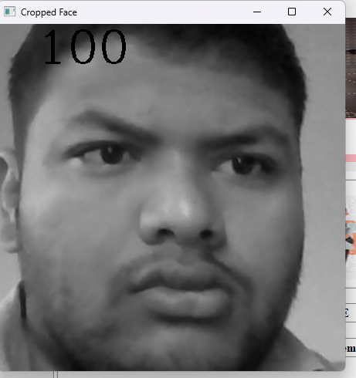
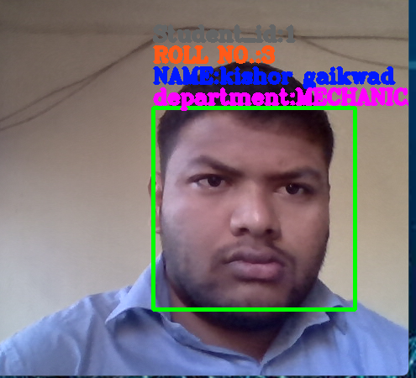
INPUT/OUTPUT
Nutan College Of Engineering And Research
Nutan College Of Engineering And Research
9

Slide 10
SYSTEM OVERVIEW
INPUT IMAGE
PRE-PROCESSING
FEATURE EXTRACTION
OUTPUT IMAGE
(KNOWN)/ (UNKNOWN)
CLASSIFIER
FACE DATABASE
Nutan College Of Engineering And Research
Nutan College Of Engineering And Research
10

Slide 11
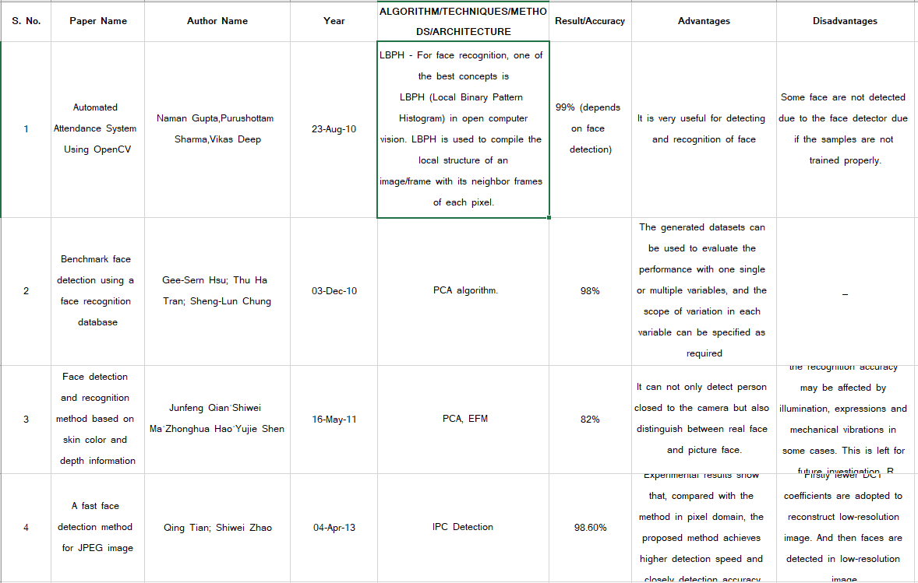
7.Literature Survey
Nutan College Of Engineering And Research
Nutan College Of Engineering And Research
11

Slide 12
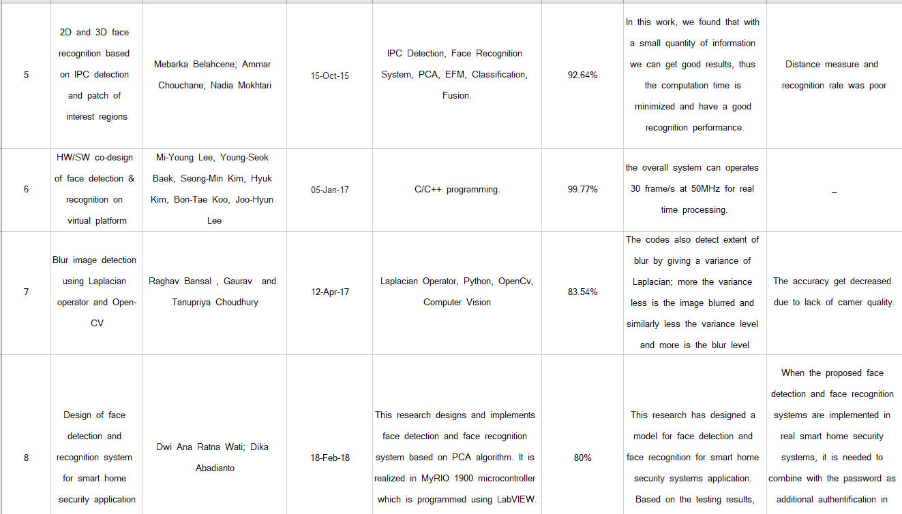
7.Literature Survey
Nutan College Of Engineering And Research
Nutan College Of Engineering And Research
12

Slide 13
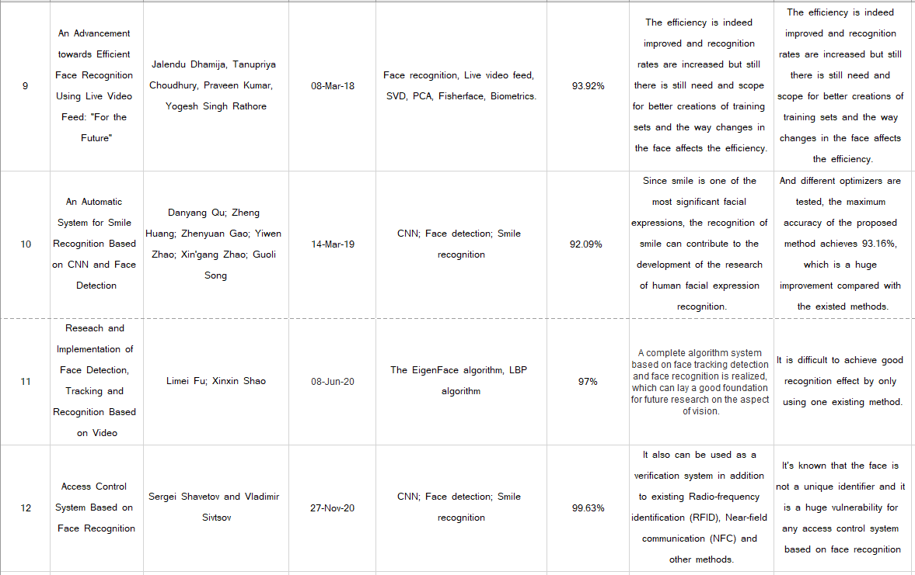
7.Literature Survey
Nutan College Of Engineering And Research
Nutan College Of Engineering And Research
13

Slide 14
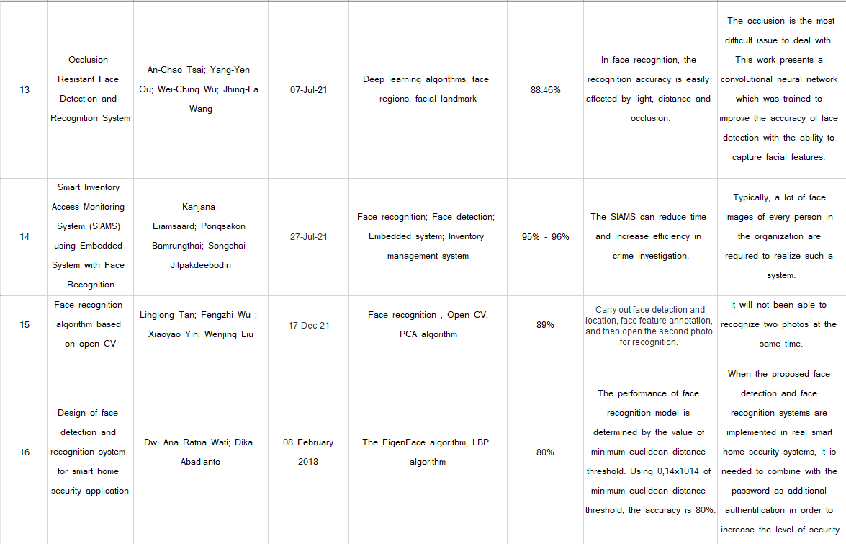
7.Literature Survey
Nutan College Of Engineering And Research
Nutan College Of Engineering And Research
14

Slide 15
8.Conclusion
In this project face detection and recognition system would certainly speed up the process of checking student attendance in comparison to other biometrics authentication methods and in the right circumstances it would be able to match their accuracy.
Nutan College Of Engineering And Research
Nutan College Of Engineering And Research
15

Slide 16
9.REFERENCE
Liang Zhixue and He Yandong, "Unrestricted Face Recognition Algorithm Based on Transfer Learning on Self-Pickup Cabinet[J]", Mathematical Problems in Engineering, 2021.
C. Shen-Chi, W. Chia-Hsiang, L. Shih-Yao, and H. Yi-Ping, "2D Face Alignment and Pose Estimation Based on 3D Facial Models," in Multimedia and Expo (ICME), 2012 IEEE International Conference on, 2012, pp. 128-133.
P. Rajiv, R. Raj, and M. Chandra, “Email based remote access and surveillance system for smart home infrastructure ଝ,” Perspect. Sci., pp. 3–5, 2016.
Liu W, Wang Y, Qiu H, et al. A Fast (l)1-solver and Its Applications to Robust Face Recognition[J]. Journal of Industrial & Managemen Optimization, 2017, 8(1):163-178
E. Sariyanidi,.H. Gunes. and A. Cavallaro. “Automatic analysis of facial affect: A survey of registration, representation, and recognition,” IEEE Transactions on Pattern Analysis & Machine Intelligence, vol. 37, num. 6, pp. 1113–1133, 2015.
R. Chellapa and S. Sirohey, "Human and Machine Recognition of Faces: A Survey," Proceedings of the IEEE. Vol. 83, no. 5, May 1995.
Nutan College Of Engineering And Research
Nutan College Of Engineering And Research
16

Slide 17
9.REFERENCE
M. Turk and A. Pentland, "Eigenfaces for recognition," J. Cognitive Neuroscience,vol. 3, 71-86., 1991.
J Lu, K. N. Plataniotis, A. N. Venetsanopoulos, Face recognition using LDA-based algorithms, “IEEE Neural Networks Transaction”, 2003.
P. Rajiv, R. Raj, and M. Chandra, “Email based remote access and surveillance system for smart home infrastructure ଝ,” Perspect. Sci., pp. 3–5, 2016.
S. R. K, T. C. Sarma, and K. S. Prasad, “Face Recognition Office Security System Using LabVIEW 8.6,” Int. J. Electron. Commun. Instrum. Eng. Res. Dev., vol. 3, no. 2, p. 8, 2013.
D. L. Swets, and J. Weng, "Using Discriminant Eigenfeatures for Image Retrieval," IEEE Trans. on Pattern Analysis and Machine Intelligence, vol. 18, no. 8, pp. 831-836, August 1996.
P.J. Philips, H. Moon, S.A. Rizvi, and P.J.Rauss, “The feret evaluation methodology for face recognition,” IEEE Trans. PAMI, vol. 22, pp. 1090–1104, Jan. 2000.
Nutan College Of Engineering And Research
Nutan College Of Engineering And Research
17

Slide 18


